Slide 1
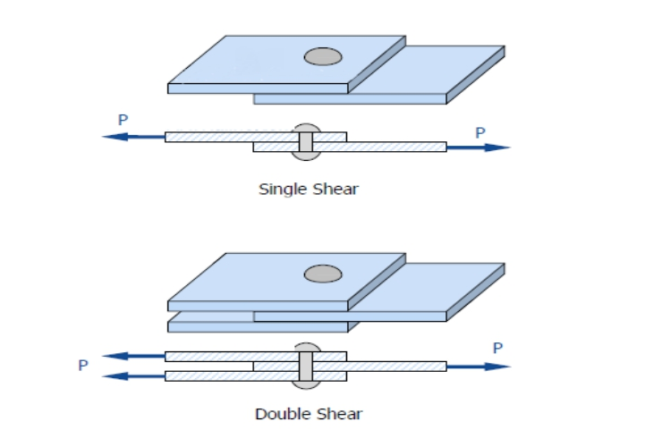
2. Shear stress
This type of stress is developed if the applied force is parallel to the resisting area. Shear stress is also known as tangential stress and it can be calculated by:
where is the shear stress, V is the shear force which passes parallel to the
resisting area and A the area being sheared.
Figure blow shows the shear occur in bolt join two plates which is called single shear and the shear occur in bolt join three plates which is called double shear.

Slide 2
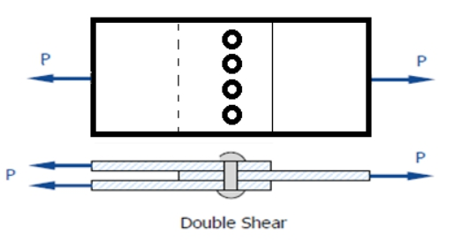
Ex.1: For the double connection shown in the figure below. Compute the shearing stress in the each bolt if the tensile force acting on each plate is P=100 kN and the diameter of the bolt is 20mm.
=39.8 MPa

Slide 3
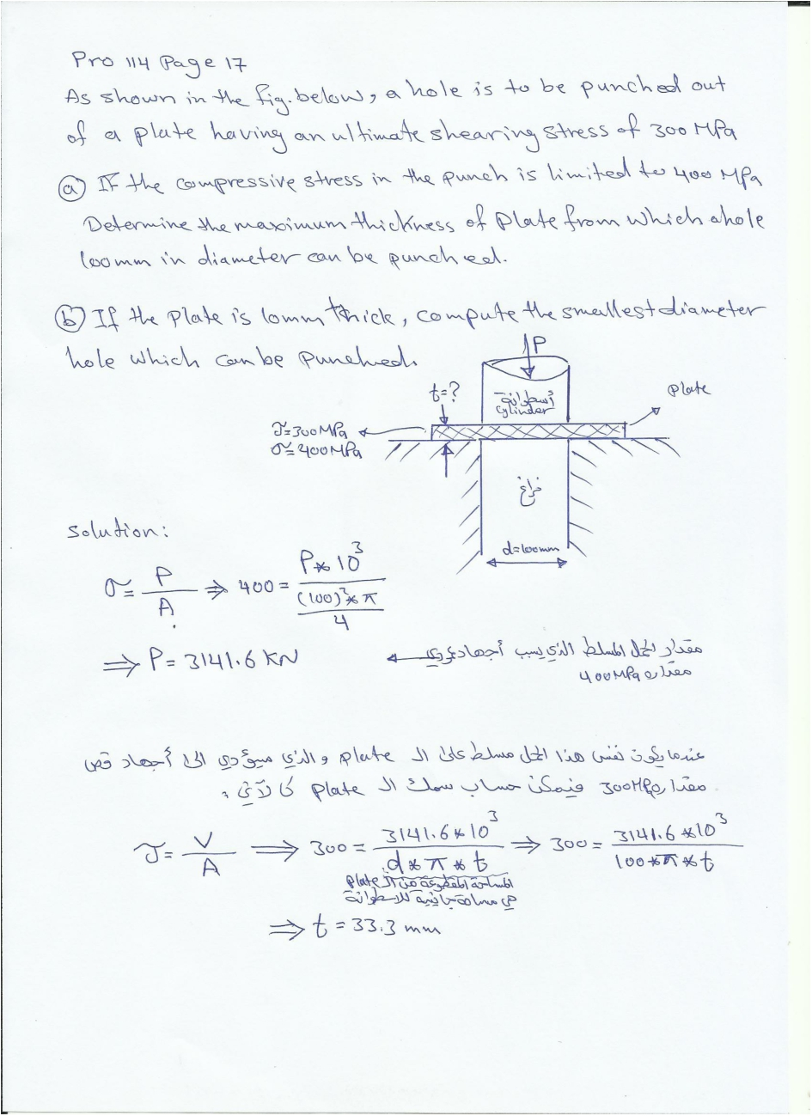

Slide 4
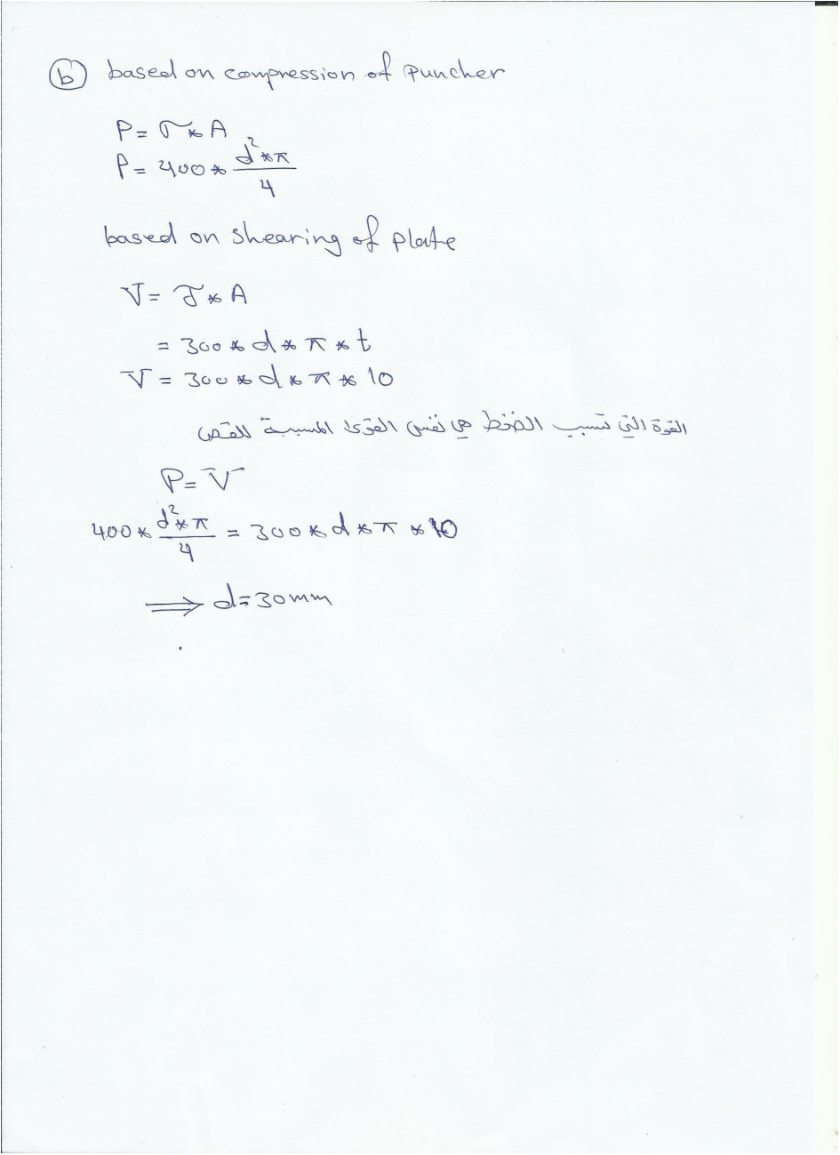

Slide 5
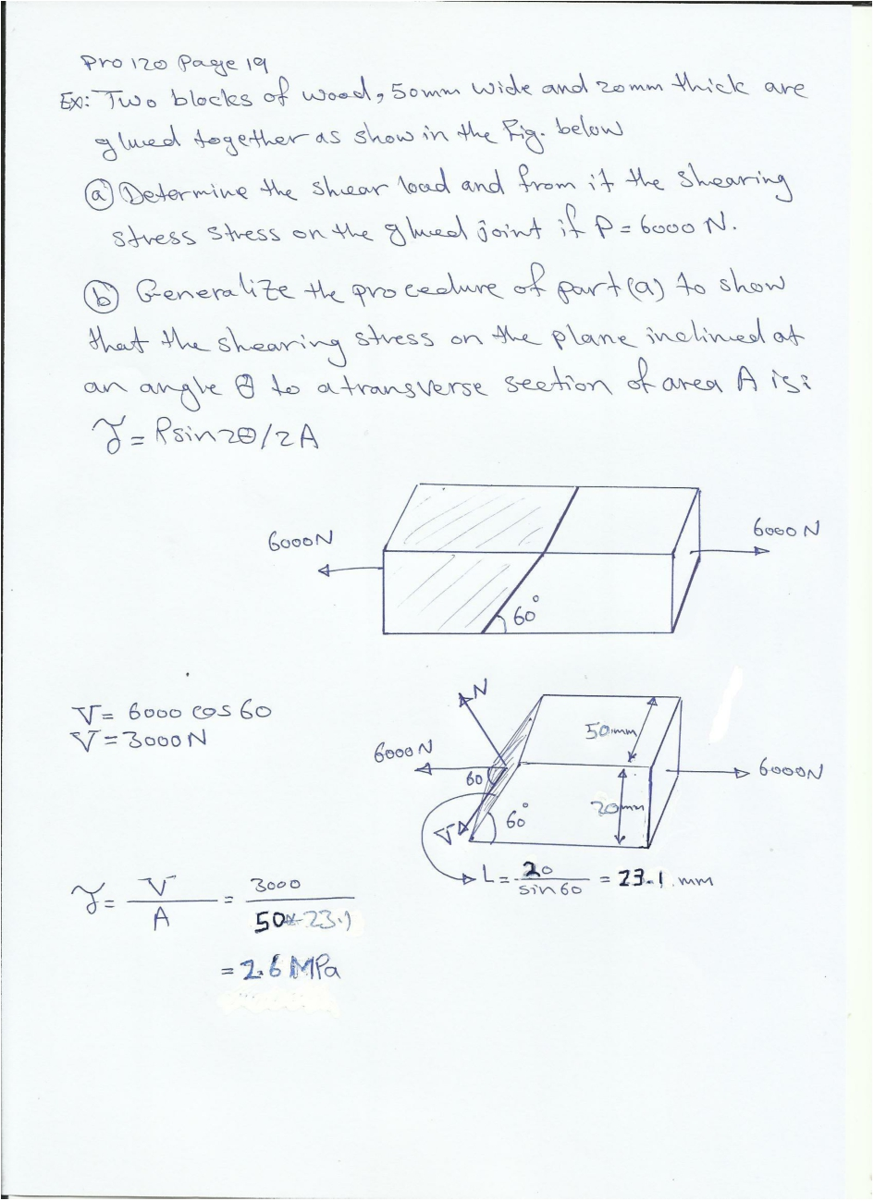

Slide 6
